Slide 1
CHAPTER 2
OPERATIONS
BINARY

Slide 2

3 - 3
4 – 4
5 – 5
8 - 8
12
20
40
??

Slide 3



SEARCH
DISCUSS
CONTEST
30 MIN
INDIV
GROUP 3
20 MIN
1 Individually, search on internet how to:
- Add 2 binary numbers
- Add 3 or 4 binary numbers
- Subtract 2 binary numbers
10 MIN
2 Share your strategy with your team
3 Competition
30MIN

Slide 4
GAME
BINARY CODE COMPETITION
30 MIN

Slide 5
Q1
01101001
00010100
+
01111011
01101111
A
B
01111101
01101101
C
D

Slide 6
Q1
01101001
00010100
+
01111011
01101111
A
B
01111101
01101101
C
D

Slide 7
Q2
10001000
00001000
+
10010000
10001000
A
B
10000100
10100000
C
D

Slide 8
Q2
10001000
00001000
+
10010000
10001000
A
B
10000100
10100000
C
D

Slide 9
Q3
01011010
01001000
+
10010000
10011010
A
B
10010101
10100010
C
D

Slide 10
Q3
01011010
01001000
+
10010000
10011010
A
B
10010101
10100010
C
D

Slide 11
Q4
01010110
01001110
+
10100100
10010100
A
B
11000100
01011110
C
D

Slide 12
Q4
01010110
01001110
+
10100100
10010100
A
B
11000100
01011110
C
D

Slide 13
0000 0111
0000 1111
0000 1111
Q5
+
+
1010 1001
0010 1111
A
B
0011 0101
0010 0101
C
D

Slide 14
0000 0111
0000 1111
0000 1111
Q5
+
+
1010 1001
0010 1111
A
B
0011 0101
0010 0101
C
D

Slide 15
Q6
1 0 1 1 0
0 1 1 0 1
-
0 1 1 0 1
1 0 0 0 1
A
B
0 1 0 0 1
1 1 0 0 1
C
D

Slide 16
Q6
1 0 1 1 0
0 1 1 0 1
-
0 1 1 0 1
1 0 0 0 1
A
B
0 1 0 0 1
1 1 0 0 1
C
D

Slide 17
Q7
11111
01010
-
110111
101011
A
B
10111
10101
C
D

Slide 18
Q7
11111
01010
-
110111
101011
A
B
10111
10101
C
D

Slide 19
Q8
10011
01000
-
110011
001011
A
B
010011
101011
C
D

Slide 20
Q8
10011
01000
-
110011
001011
A
B
010011
101011
C
D

Slide 21
Q9
00111
00010
00001
-
00100
01000
A
B
010010
001010
C
D

Slide 22
Q9
00111
00010
00001
-
00100
01000
A
B
010010
001010
C
D

Slide 23
Q10
01111
00101
00011
-
10111
01011
A
B
010110
00111
C
D

Slide 24
Q10
01111
00101
00011
-
10111
01011
A
B
010110
00111
C
D

Slide 25
11111
01011
00101
00001
Q11
-
101110
011010
A
B
001110
011100
C
D

Slide 26
11111
01011
00101
00001
Q12
-
101110
011010
A
B
001110
011100
C
D

Slide 27
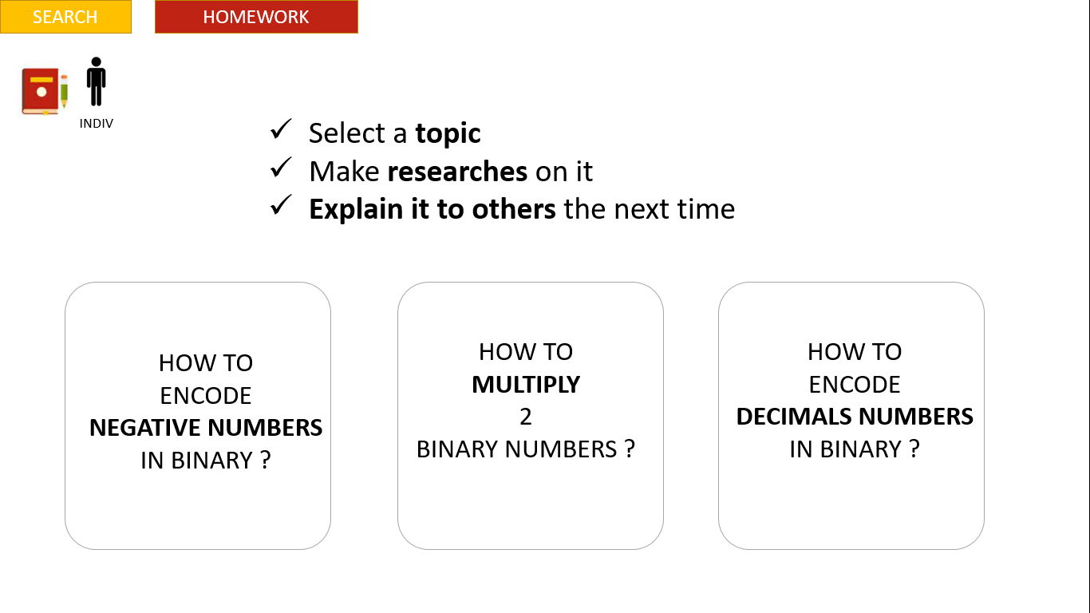
FLOAT

